Slide 1
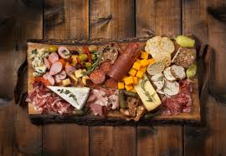
APÉRO

Slide 2
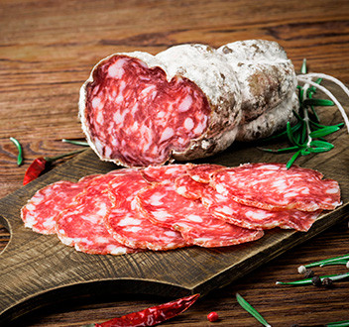
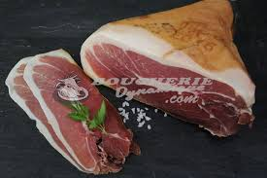
CHARCUTERIE
Saucisson
Prosciutto

Slide 3
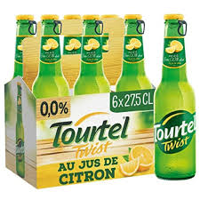
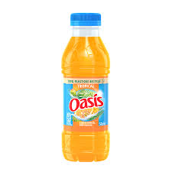
DRINKS

Slide 4
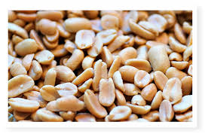
Peanut

Slide 5
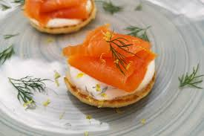
Salmon Toast with butter

Slide 6
Thanks for listening to us
The apero should be enjoyed in modération

Slide 7
Rudy:
Today, we present to you the French Apéro.
The Apéro is a snack before diner. To begin, I'm going to talk about charcuterie.
Saucisson is a type of charcuterie in french cuisine.
It is typically made of pork, or a mixture of pork and other meats.
Prosciutto is pork meat, in French it's called "jambon de pays"
Enzo:
Oasis is drink made of a mix of fruits.
Tourtel Twist is a non alcoholic fruit flavoured beer.
Mylan:
The peanuts have different flavours: Salted peanuts, sugared peanuts.
Ex: sugar peanut is for Snickers.
Paul:
The salmon toast with butter is butter spread onto toast and a slice of salmon

