Slide 1
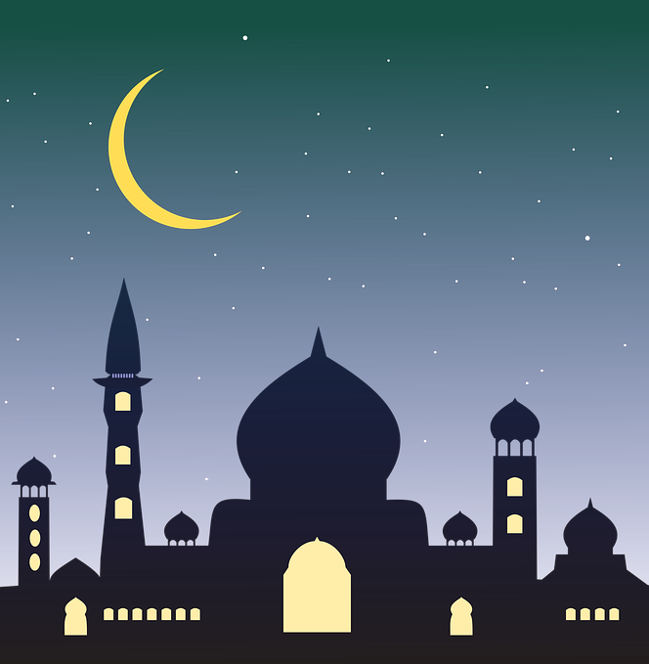
Eïd
What is it ??
Juhayna and Ifemi

Slide 2
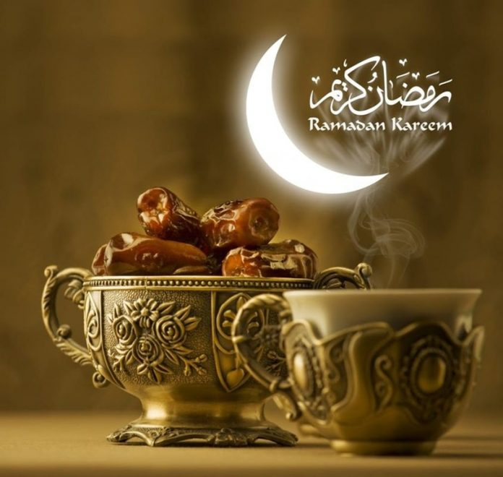
Fasting
The Eid festival is a reward for having fasted for a month.

Slide 3
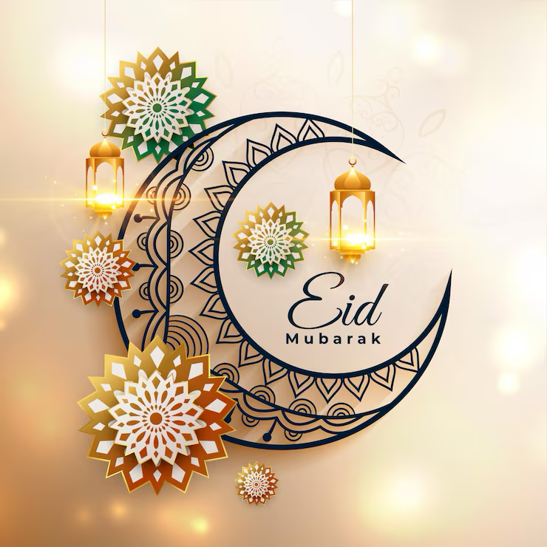
How it works
Eid is usually celebrated in March or April, depending on the lunar calendar. People get up early to go to the mosque, then they eat and open gifts.

Slide 4
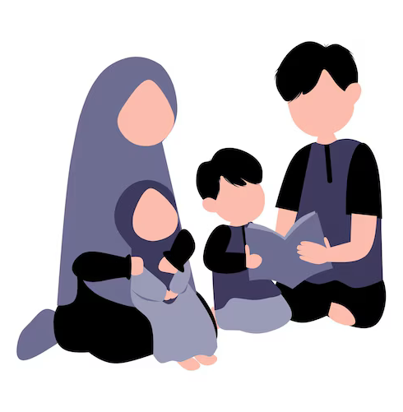
Family
We're going to see the family; it's a day of sharing with loved ones.

Slide 5
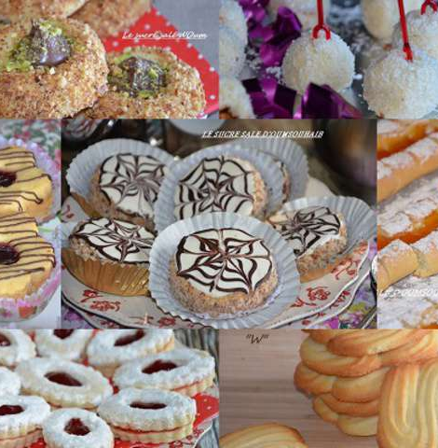
Food
On this day, people eat more sweets and prepare oriental pastries in advance.

Slide 6
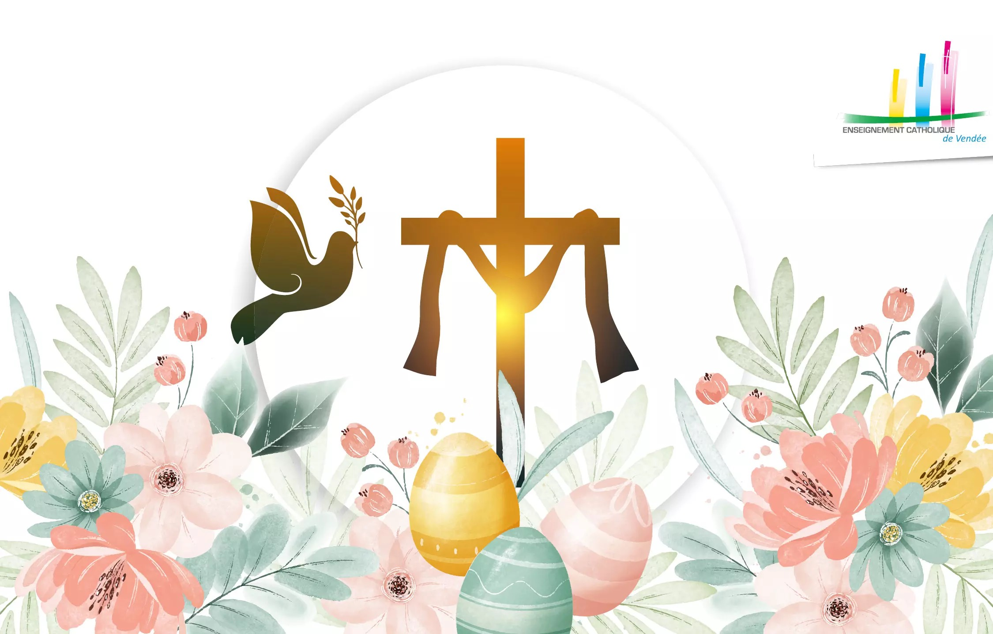
Easter in Christianity
Easter is the most important Christian celebration. It celebrates the resurrection of Jesus Christ three days after his death. Catholics and Orthodox Christians celebrate Easter in similar but different ways
Anzhelina , Clélia, Marouane and Oxhana

Slide 7
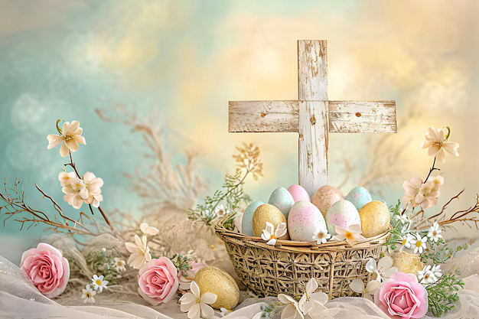
The history of Easter
Easter comes from a Jewish festival called Passover. Christians celebrate Jesus’ resurrection as a symbol of life and hope. The date changes every year so Catholics and Orthodox may celebrate it on different days because they use different calendars

Slide 8
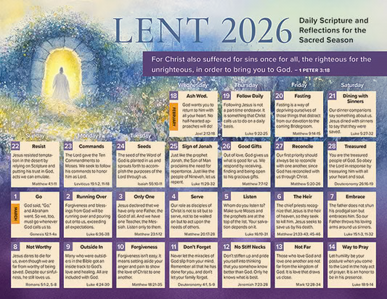
Lent: Preparing for Easter
Lent is the 40-day period before Easter. Christians pray more, make sacrifices, and think about their actions. Catholics often give up things they enjoy, while Orthodox Christians have more stricter food rules

Slide 9

How Catholics Christians celebrate Easter
Catholics celebrate Holy Week before Easter, including Palm Sunday, Good Friday and Easter Sunday. They go to church, sing songs, and spend time with their families. Easter eggs and chocolate eggs are popular traditions that represent new life.

Slide 10
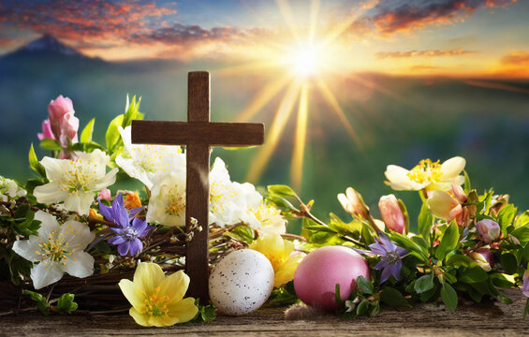
How Orthodox Christians celebrate Easter
Orthodox Christians call Easter « Pascha ». Their celebration includes prayers, candles, and midnight ceremony to celebrate Jesus’ resurrection. After fasting for a long time, families share special food together. They also decorate red eggs, which symbolize life and Jesus’ sacrifice.

Slide 11
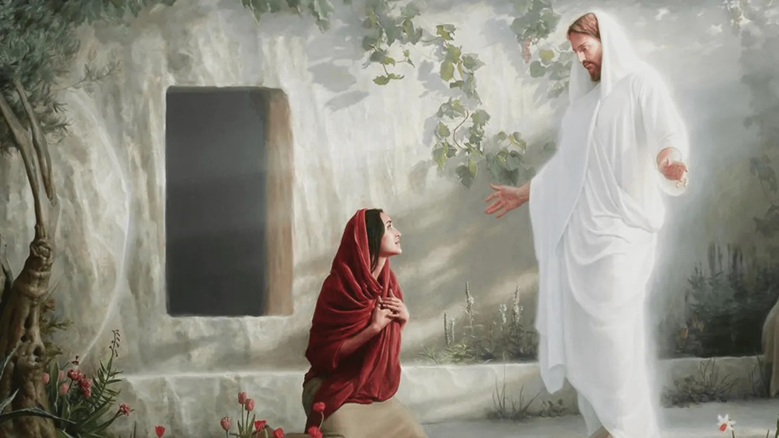
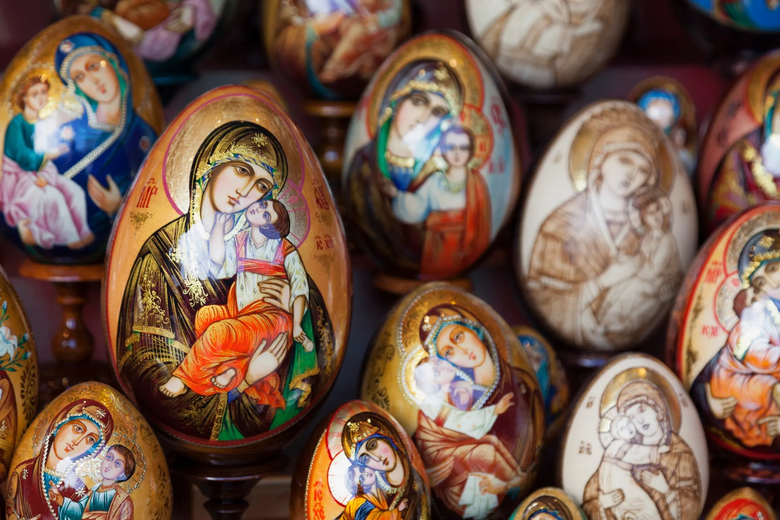
Conclusion
Catholics and Orthodox Christians believe the same story of Jesus’ resurrection, but they celebrate it in different ways sometimes on different dates. Despite these differences, Easter is a time of joy, hope, and new life for all Christians around the world

Slide 12
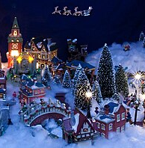
Christmas
By Melvyn and Waçanne

Slide 13
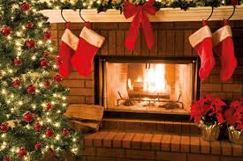
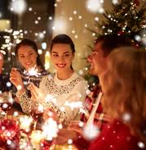
When ?
Christmas is a holiday celebrated on December 25th. Families gather, people sing Christmas Carols and eat. On Christmas Eve (December 24th), people also have dinner and open presents at midnight.
It’s a time of family sharing.

Slide 14
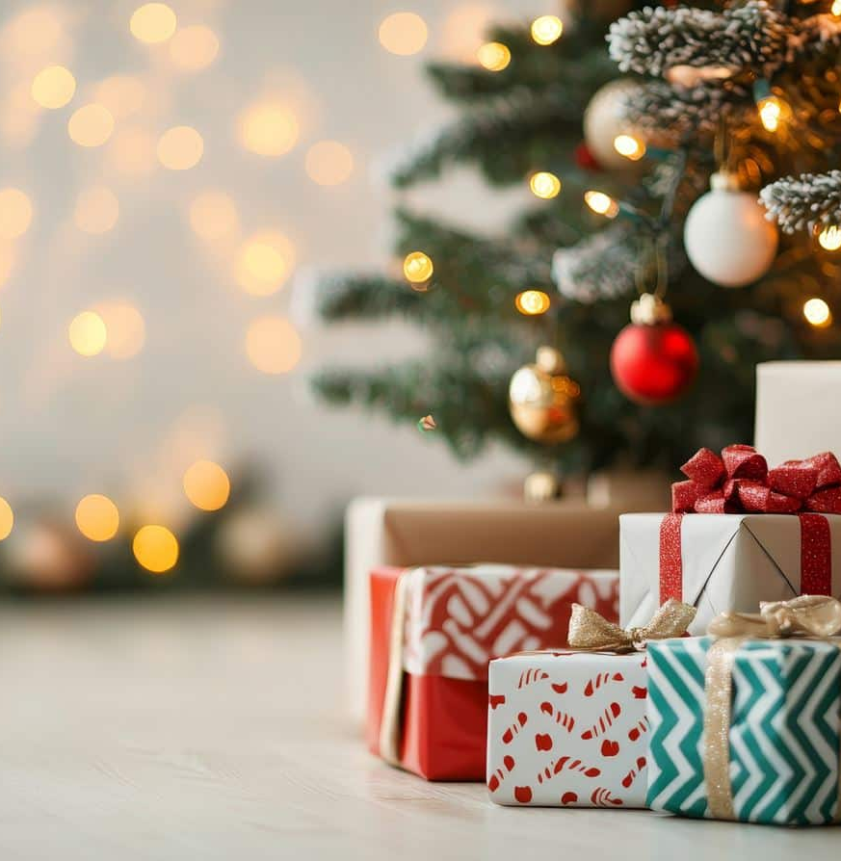
The gifts
The gifts are put the day before under the tree, they are deposited by Santa Claus.

Slide 15
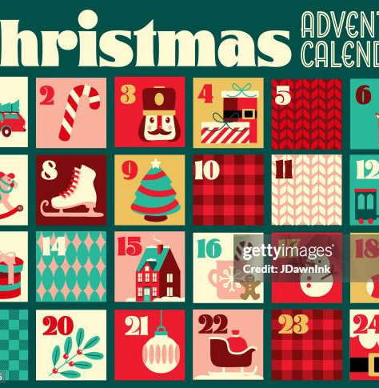
The calendar in chocolate
Children open a box each day since the beginning of December, a chocolate is hidden to make them wait before the D-day

Slide 16
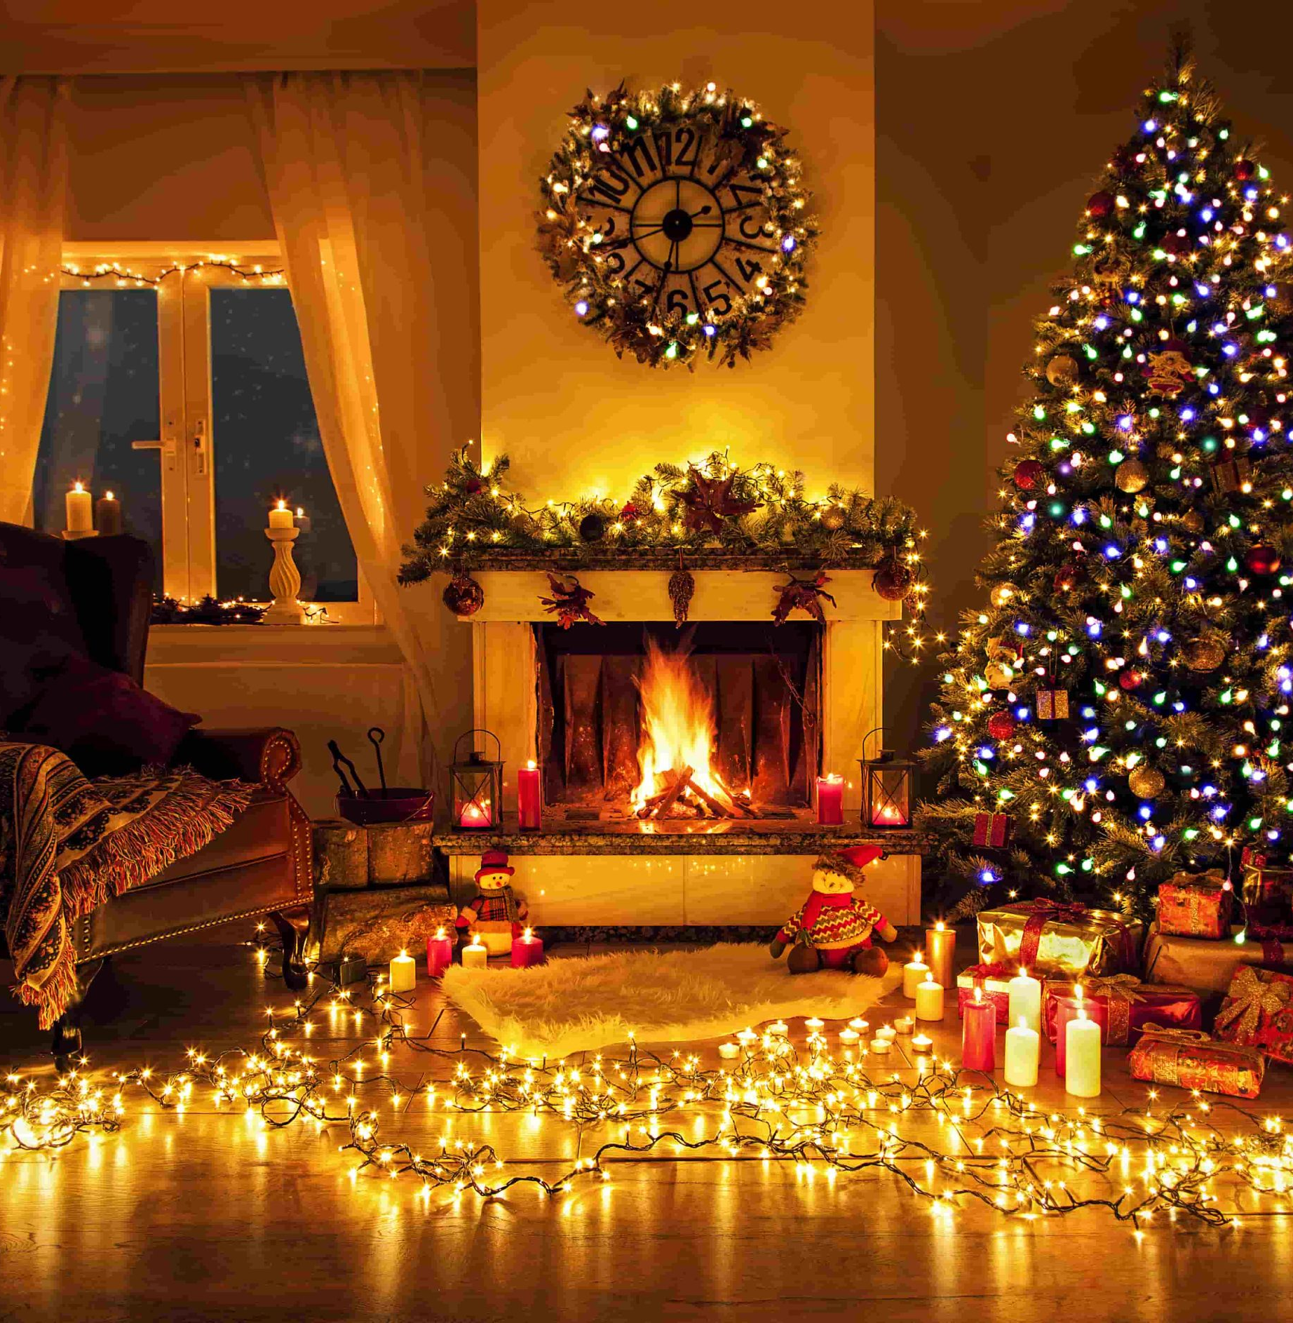
The Decoration
The houses are decorated with a fir tree surrounded by tinsels that shine and ornaments colored in red, green, gold and silver usually.
On the chimneys we put socks in which we put candy and chocolate.

Slide 17
Thank you and Goodbye ;)

