Slide 1
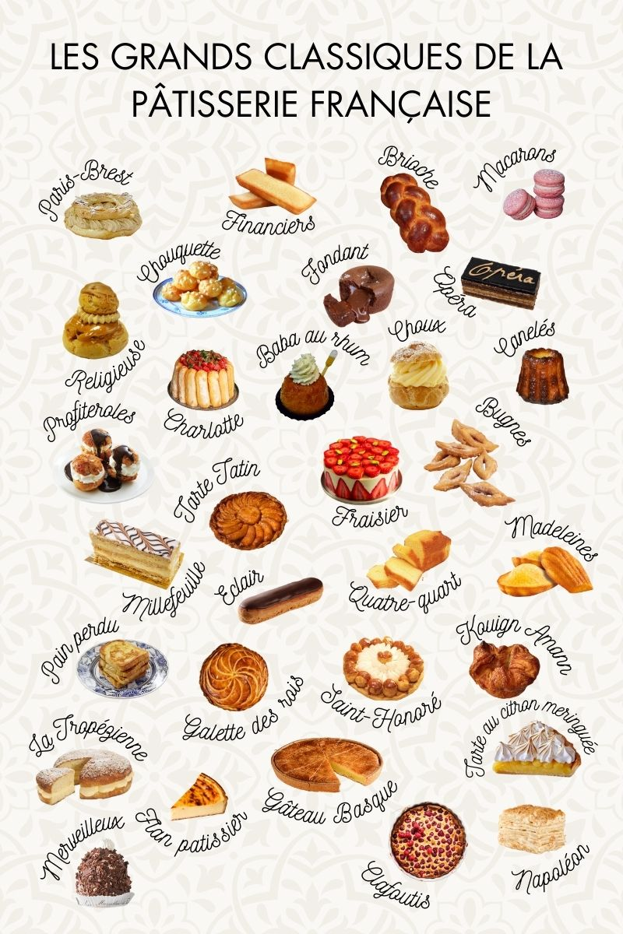
The French patisserie
Heather, Lya and Ondina

Slide 2
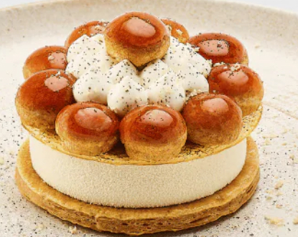
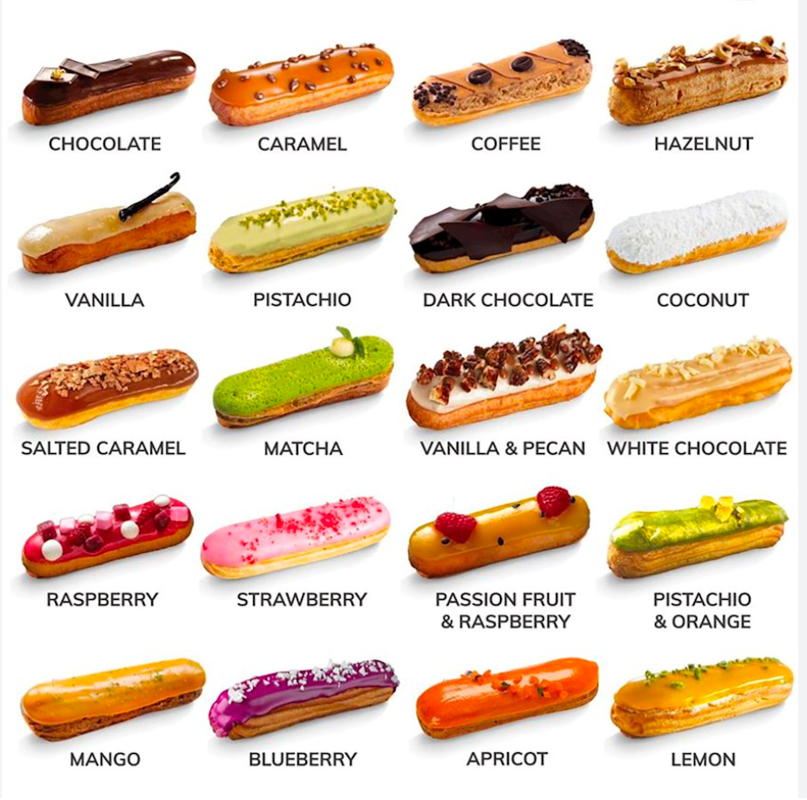
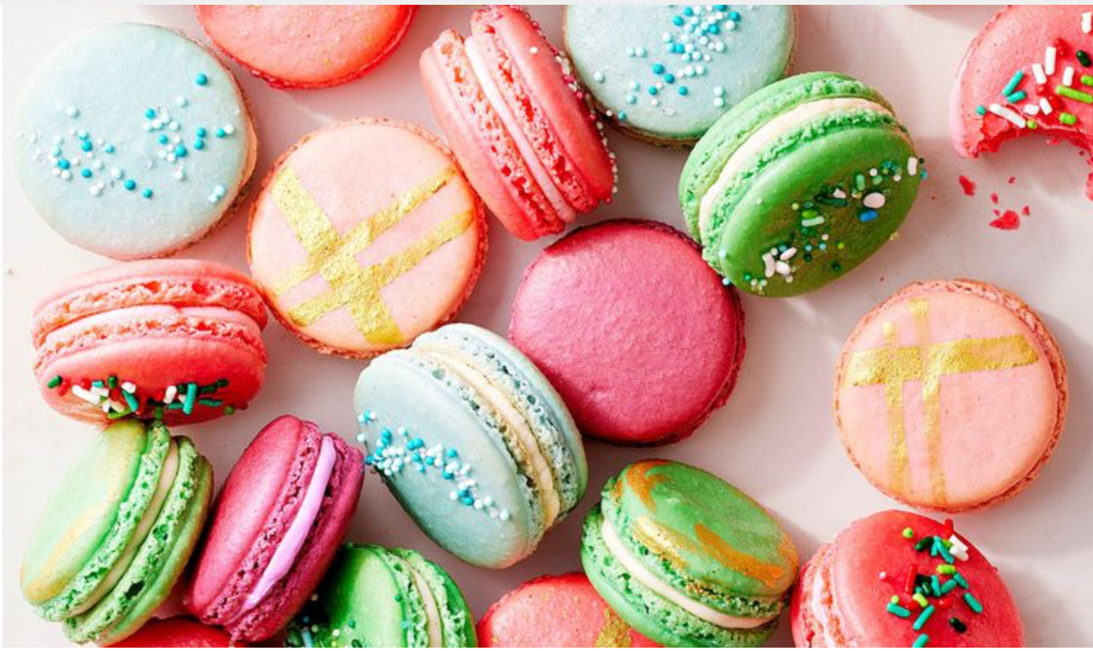
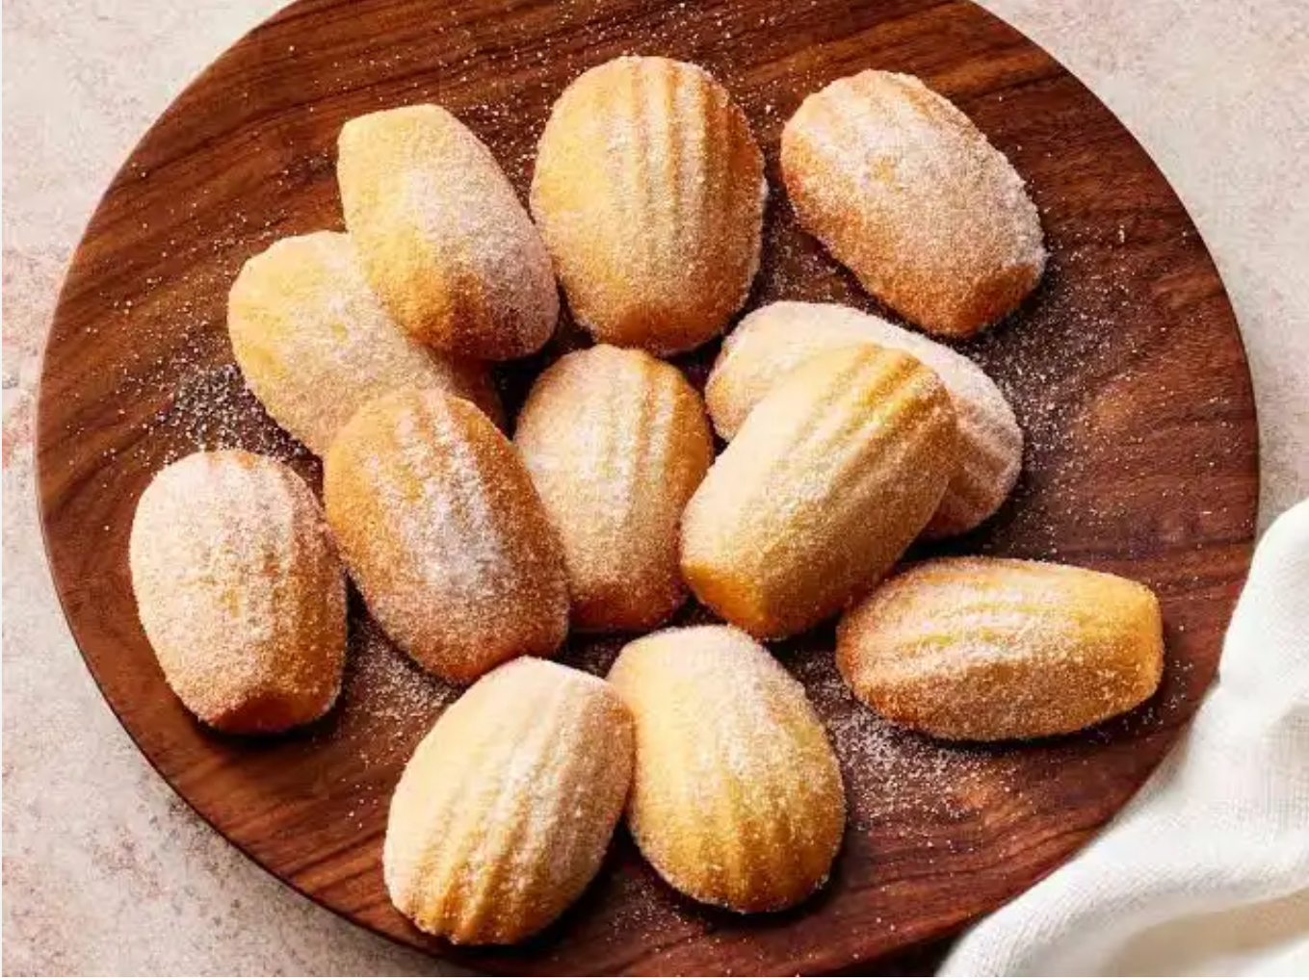
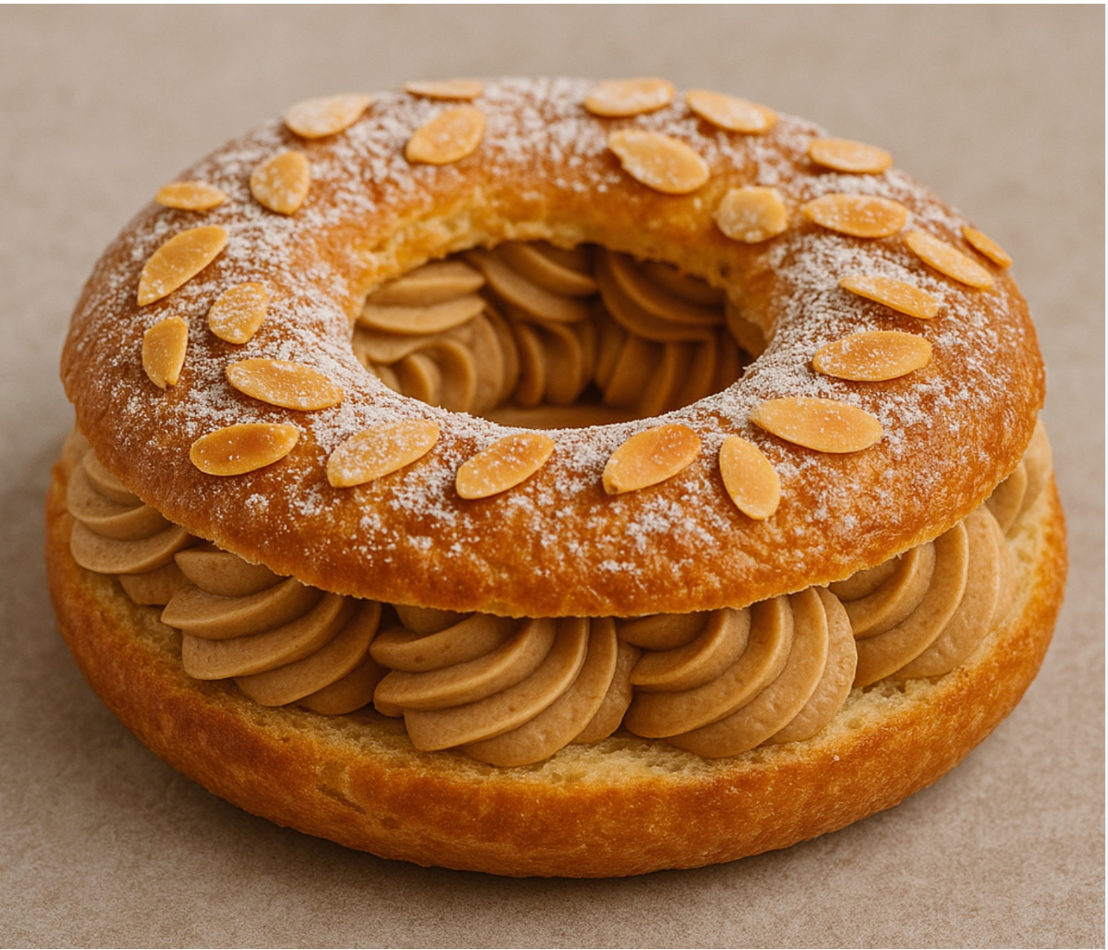
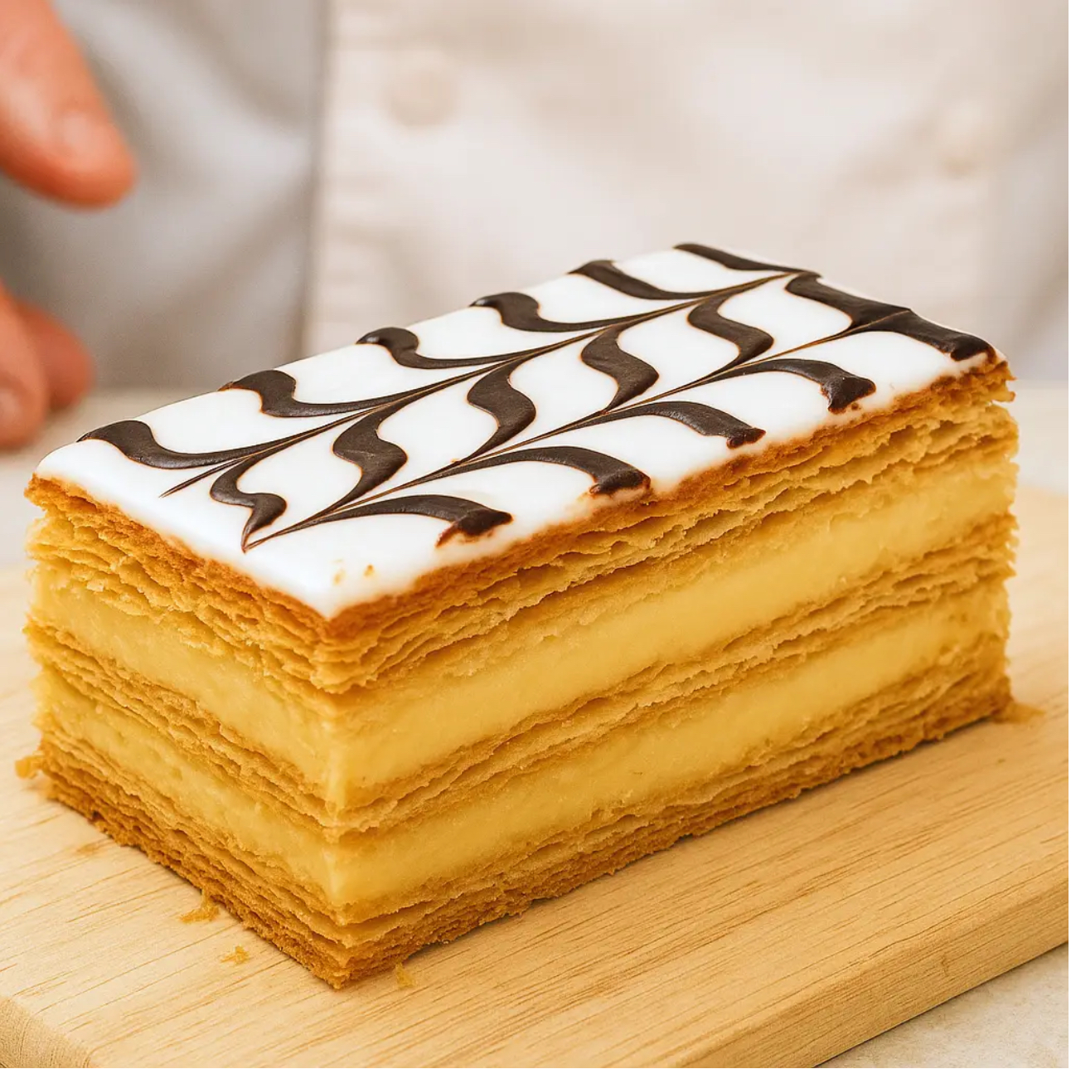
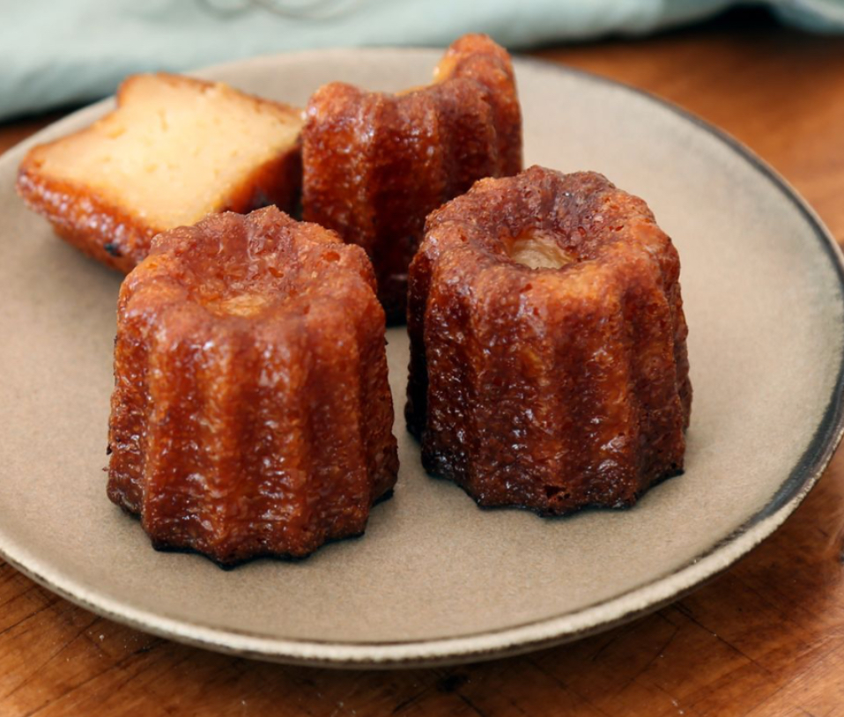
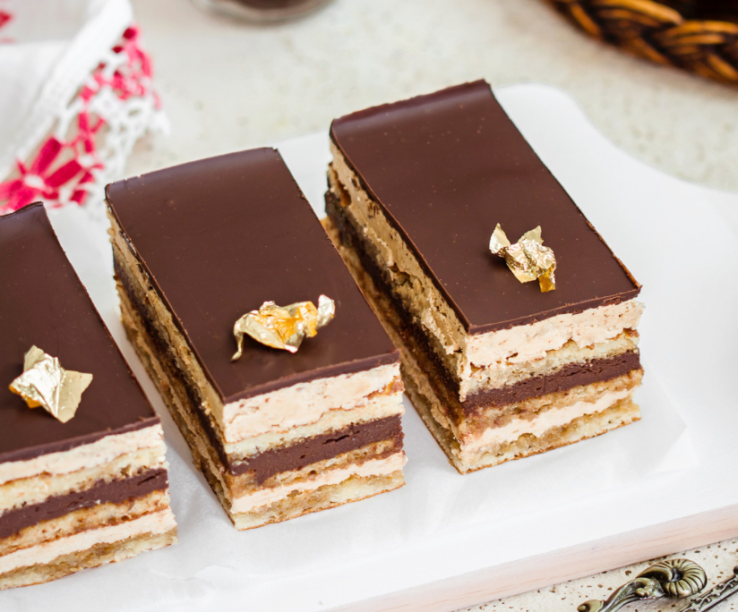
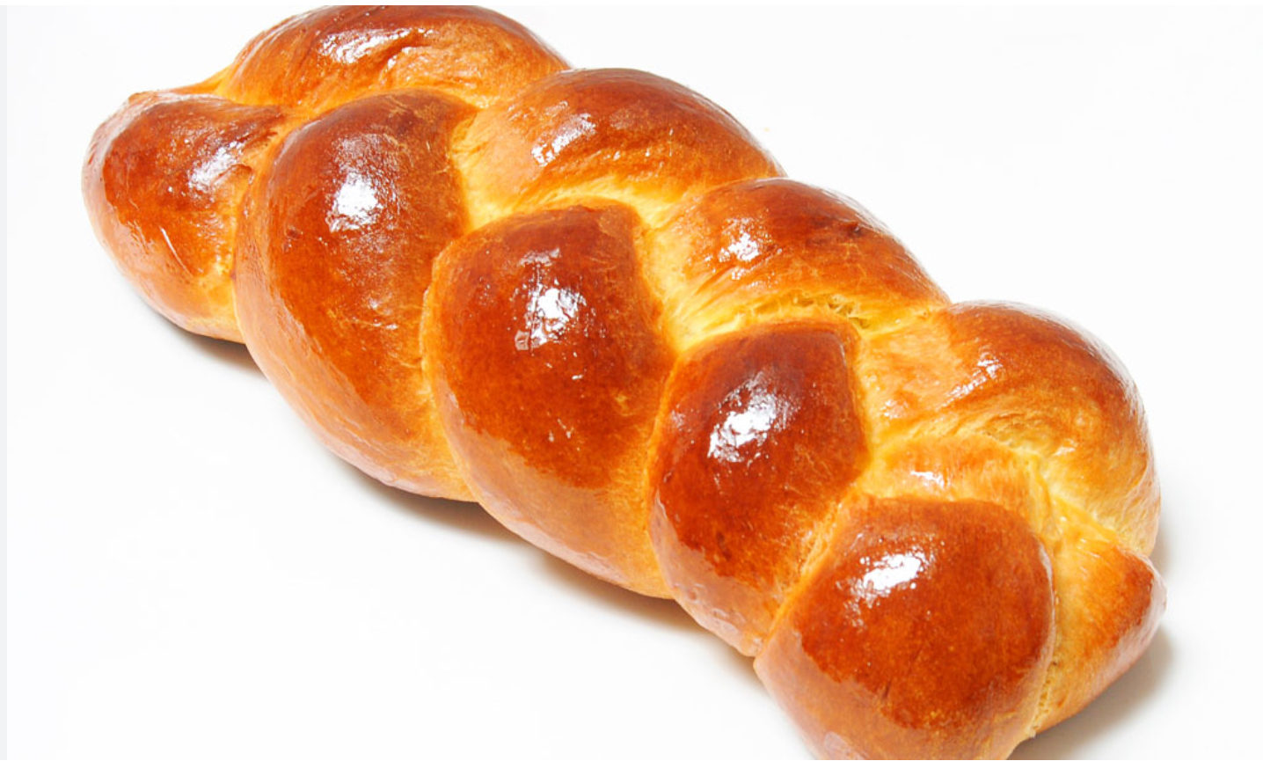
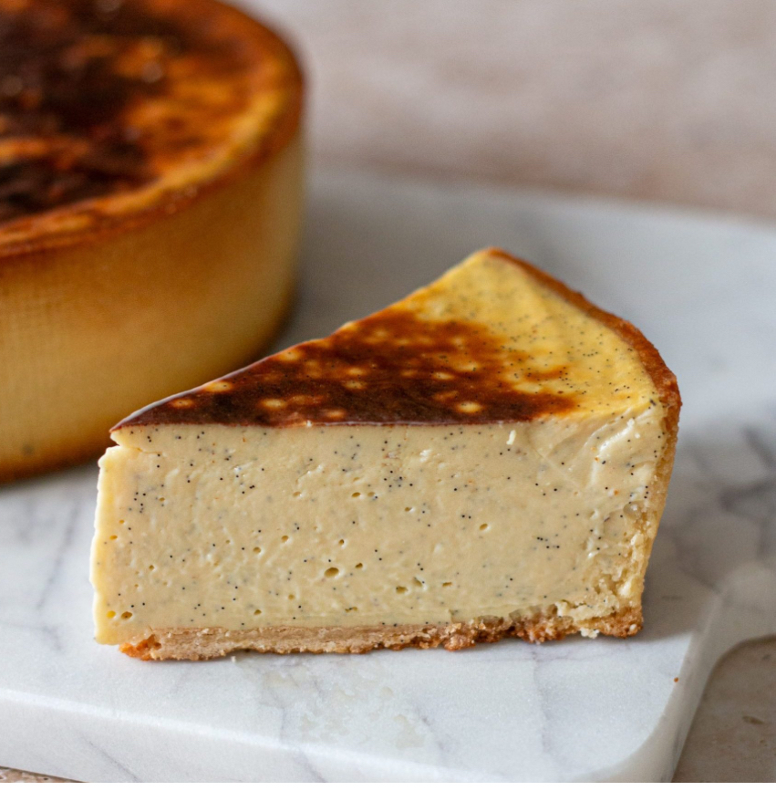
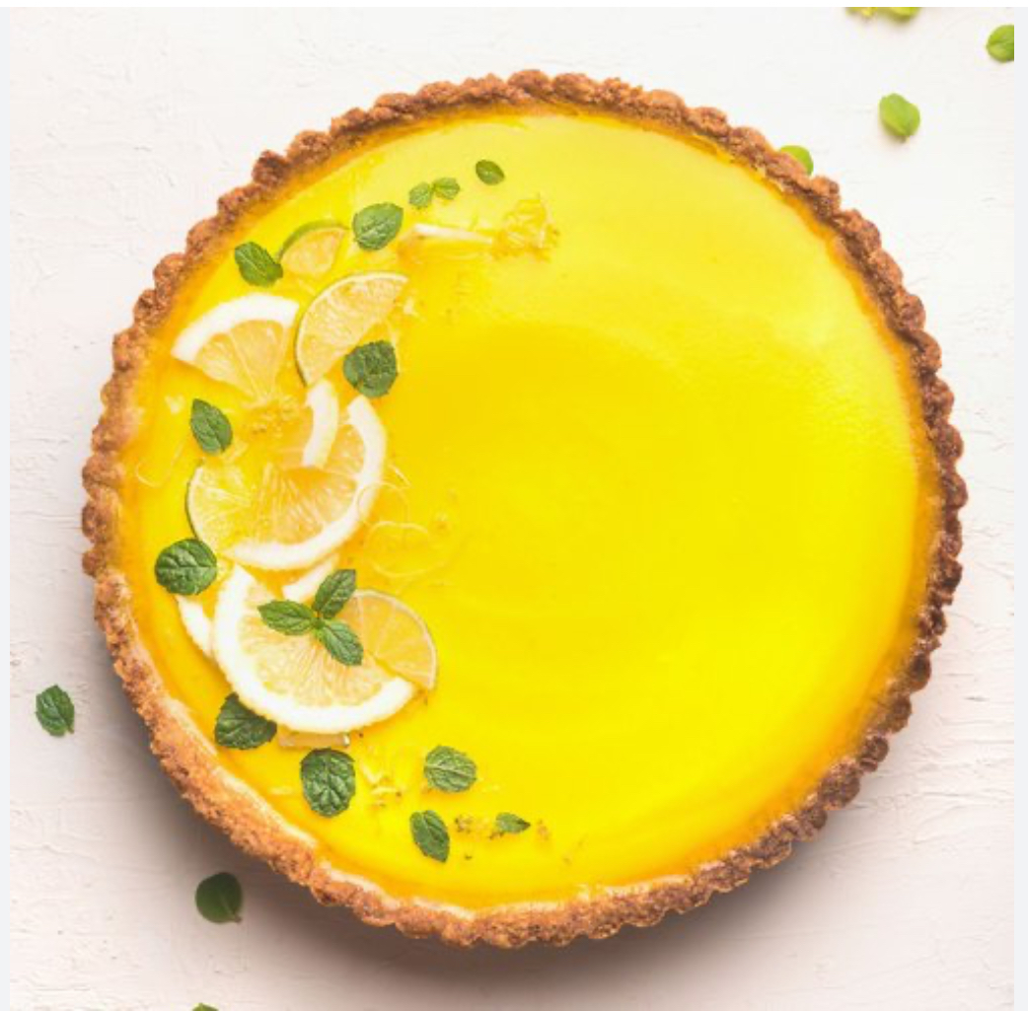
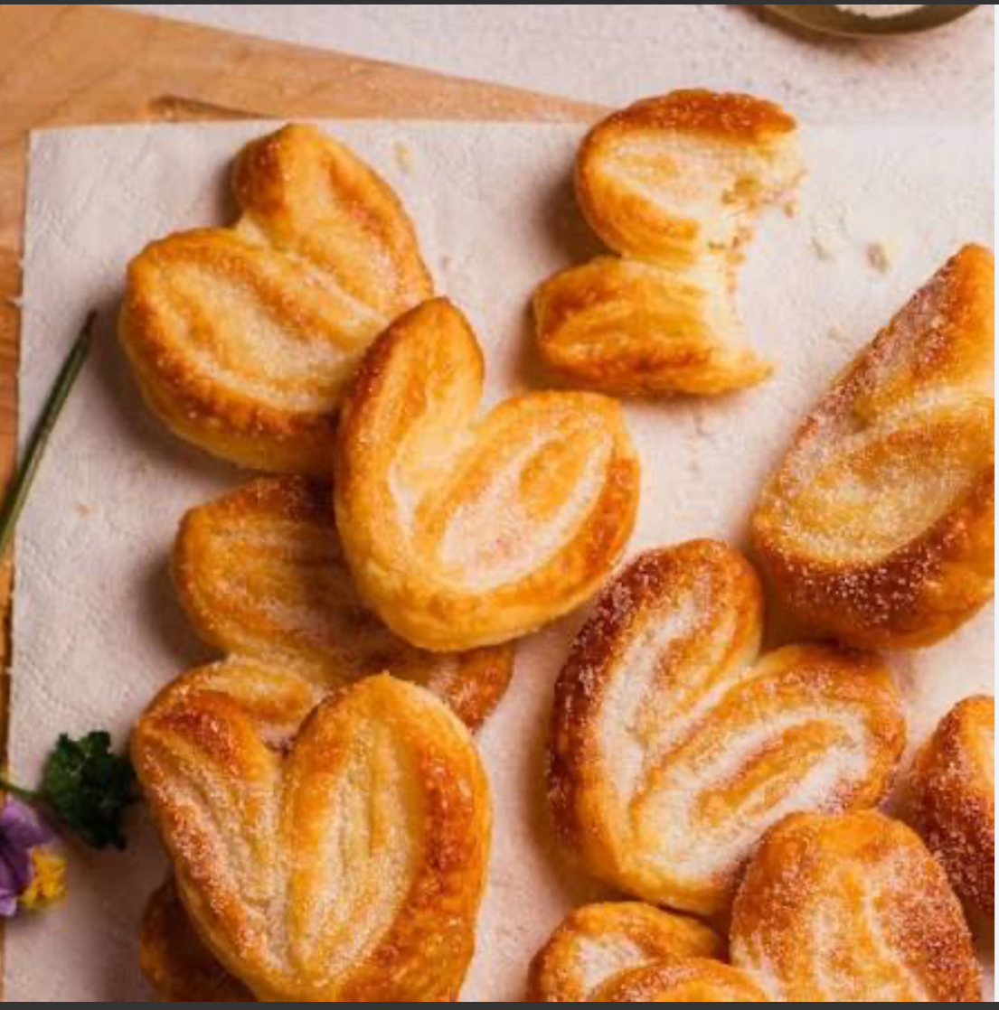
Today we show you the French patisserie
We have the
Saint-Honoré
Mille-feuille
Paris-brest
Éclair
Macaron
Madeleine
Tarte au citron
Palmier
Cannelé
Opéra
Brioche
Flan

Slide 3
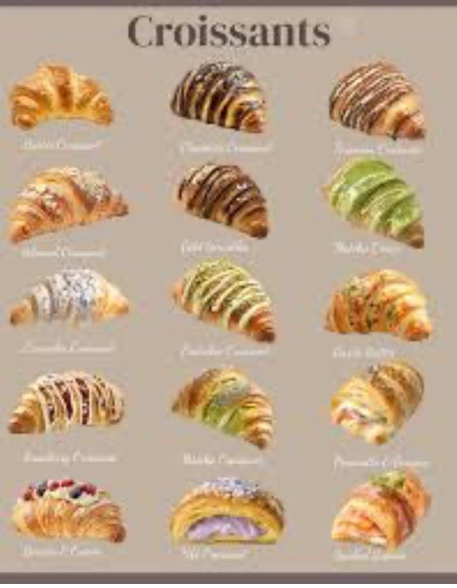
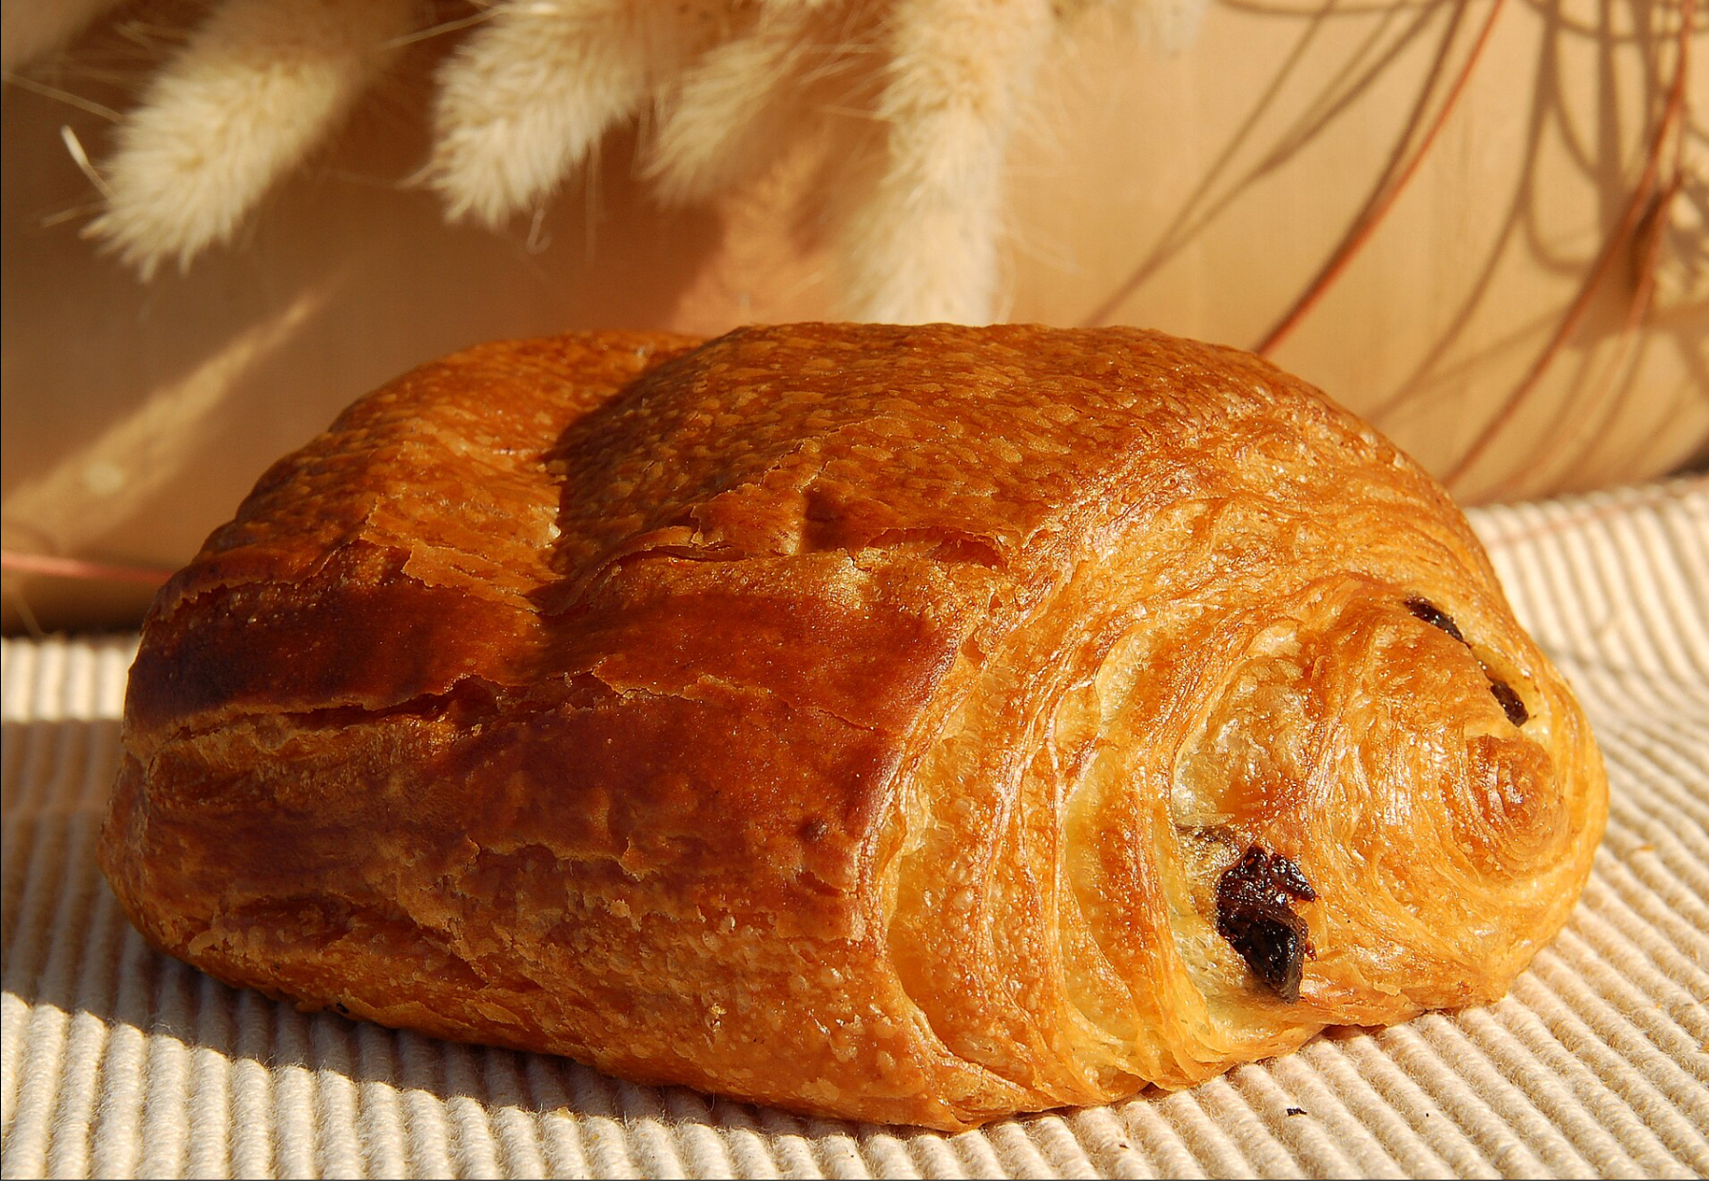
We have the 2 best seller in French pastry : croissants and the pains au chocolat
Croissants
Pains au chocolat

Slide 4
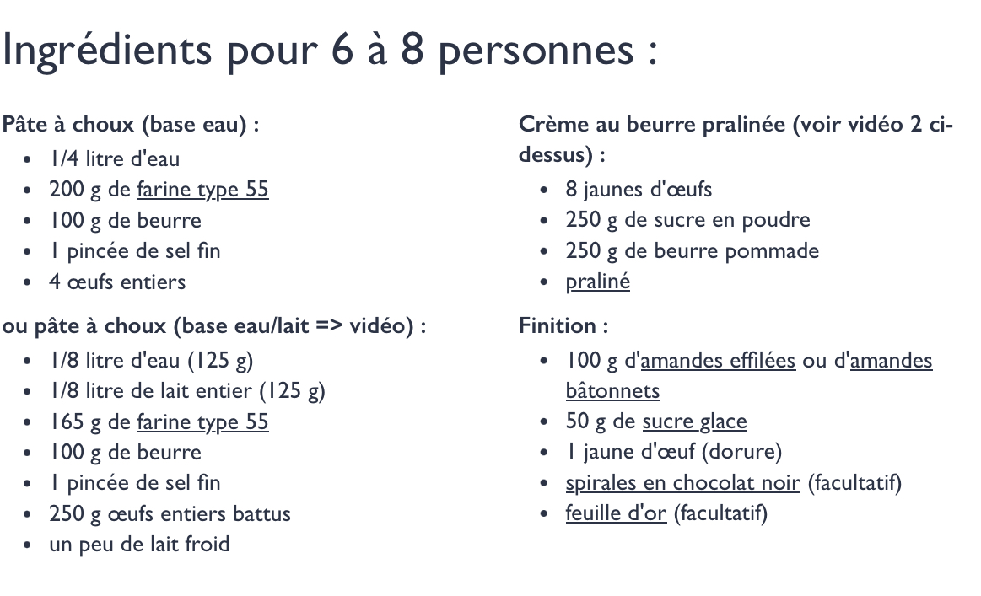
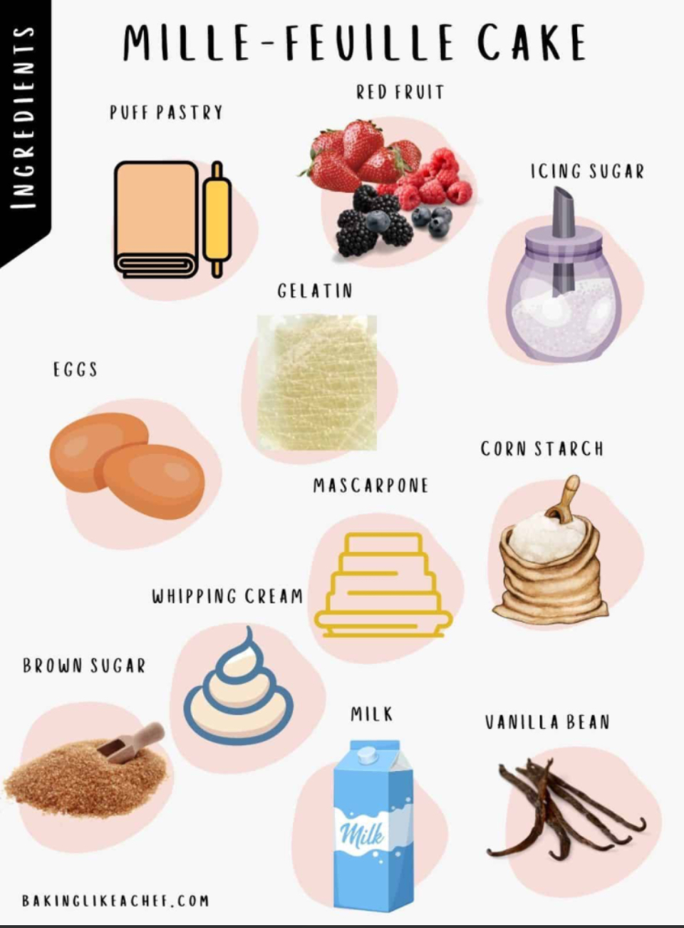
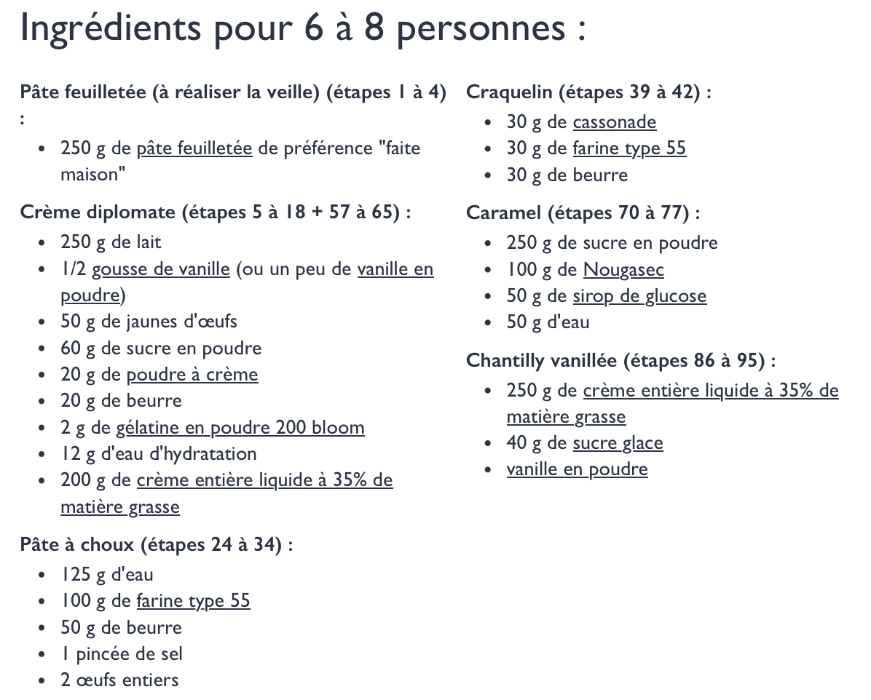
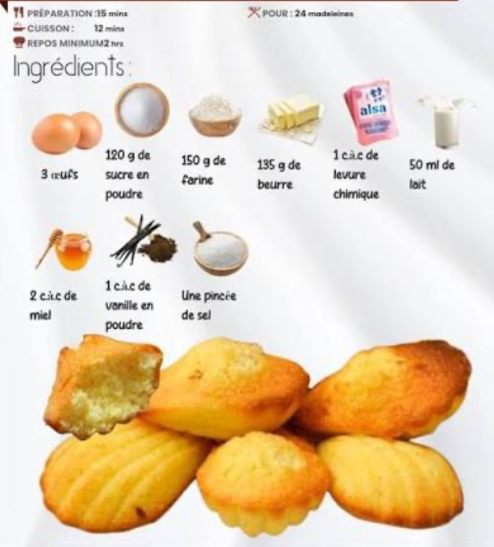
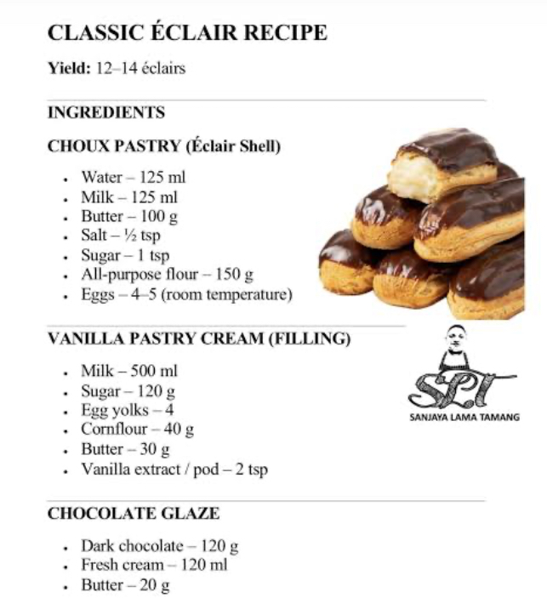
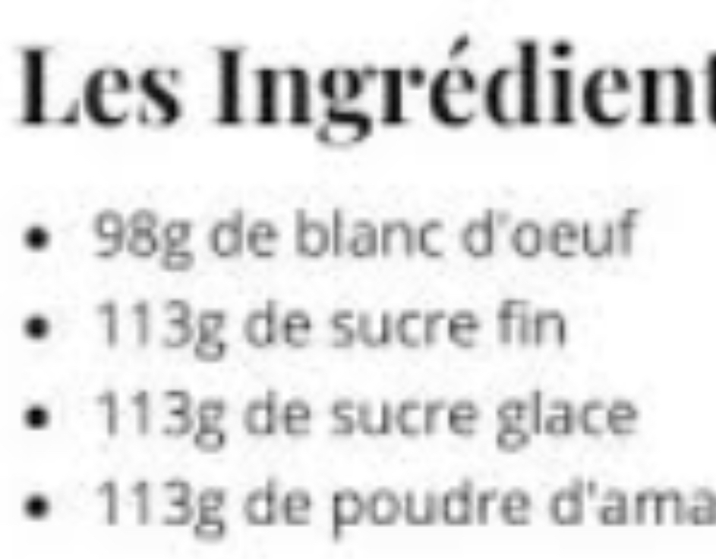
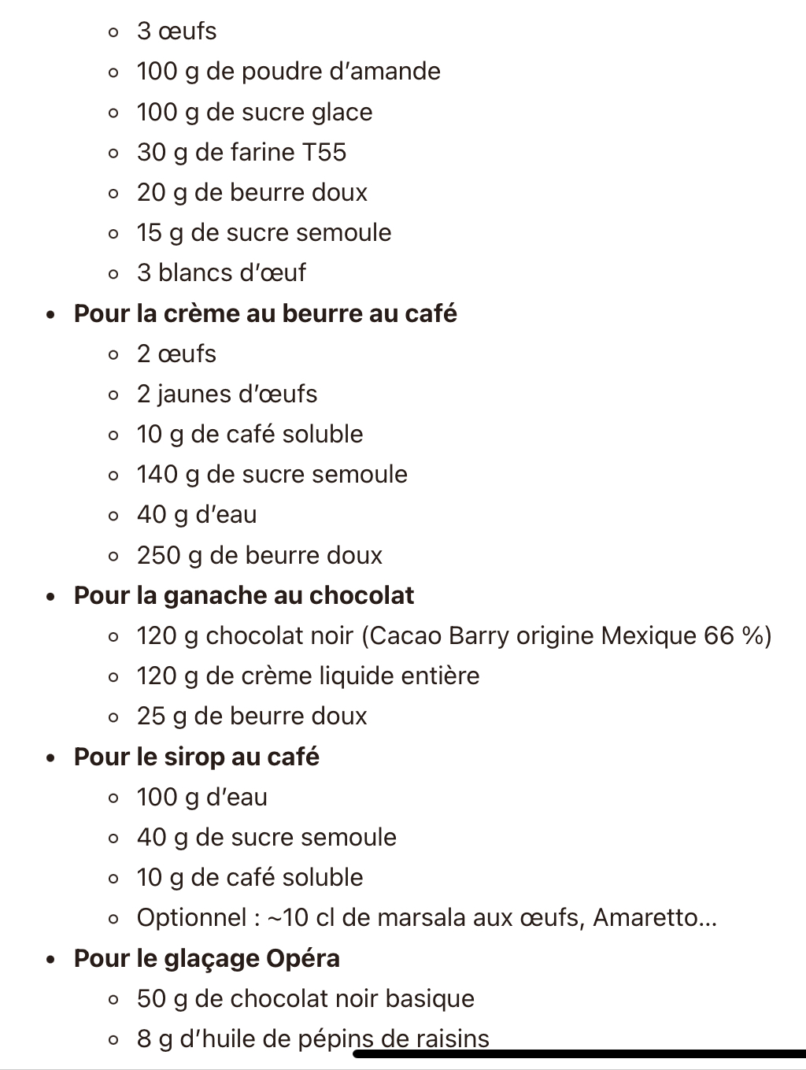
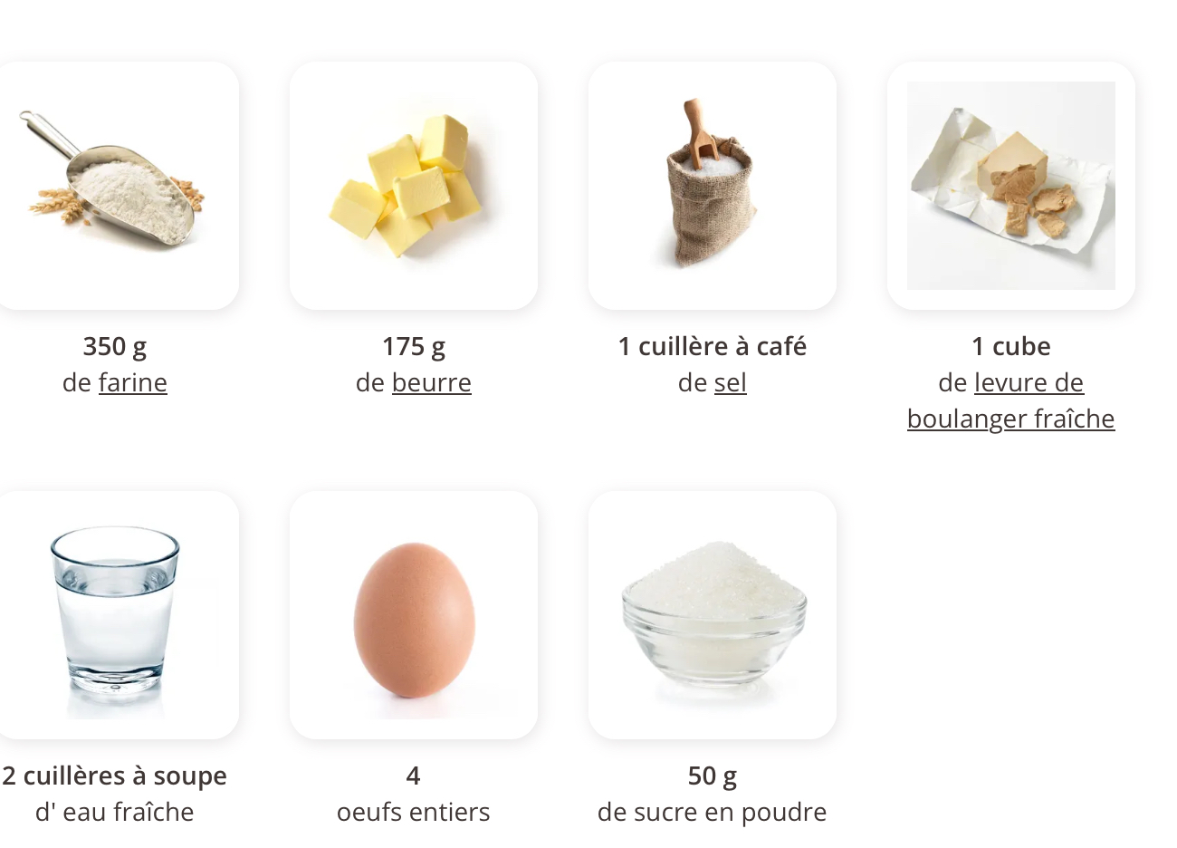
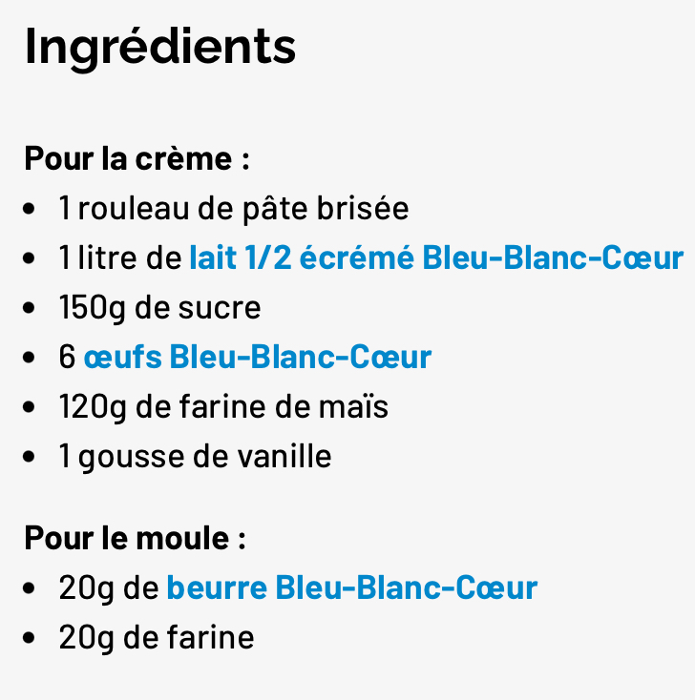
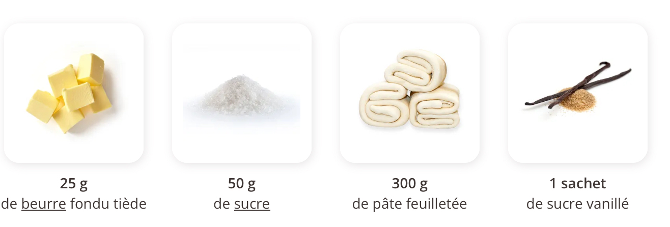
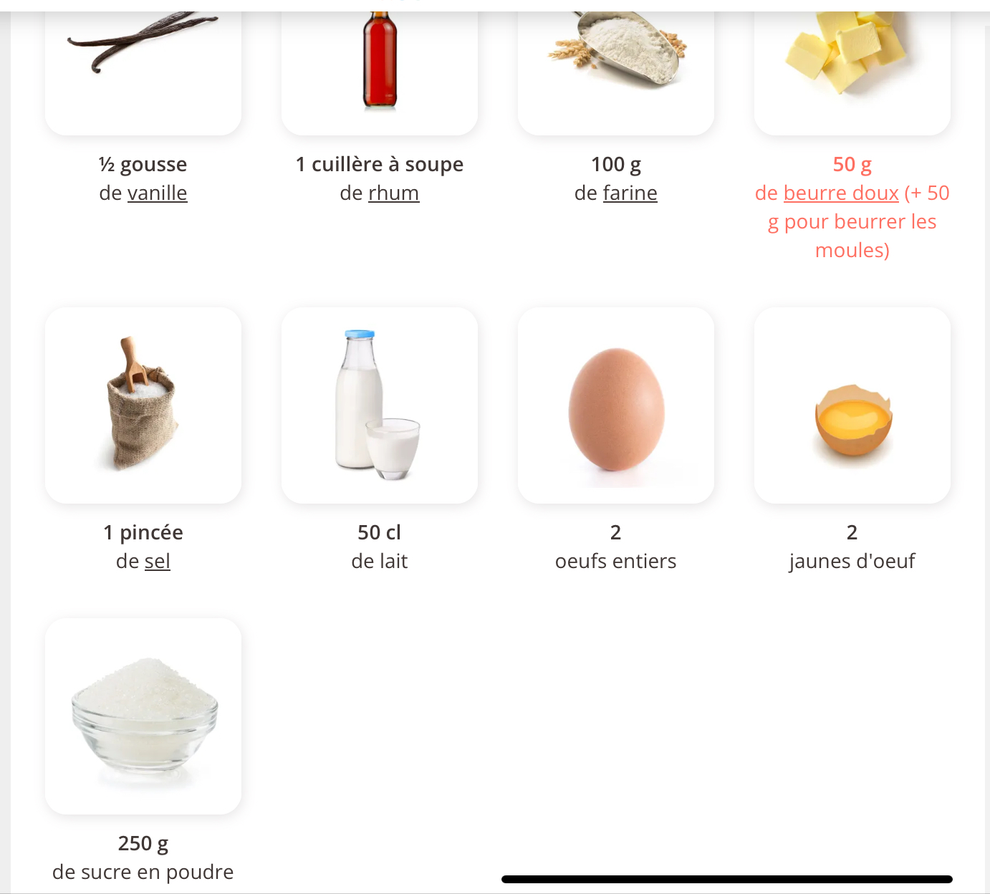
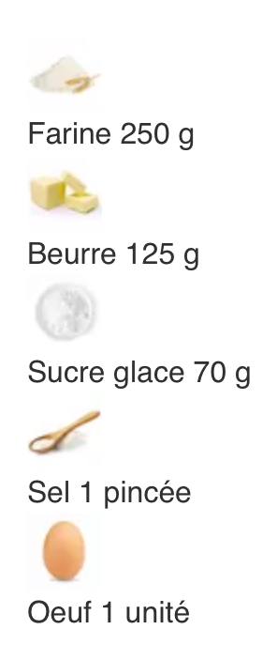
Saint-Honoré
Paris-brest
Macaron
Mille-feuille
Madeleine
Éclair
Ingrédients
Brioche
Opéra
Flan
Tarte au citron
Palmier
Cannelé

Slide 5
Cookies and candy
By Manavaï, Sixtine, Lisa and Maelle

Slide 6
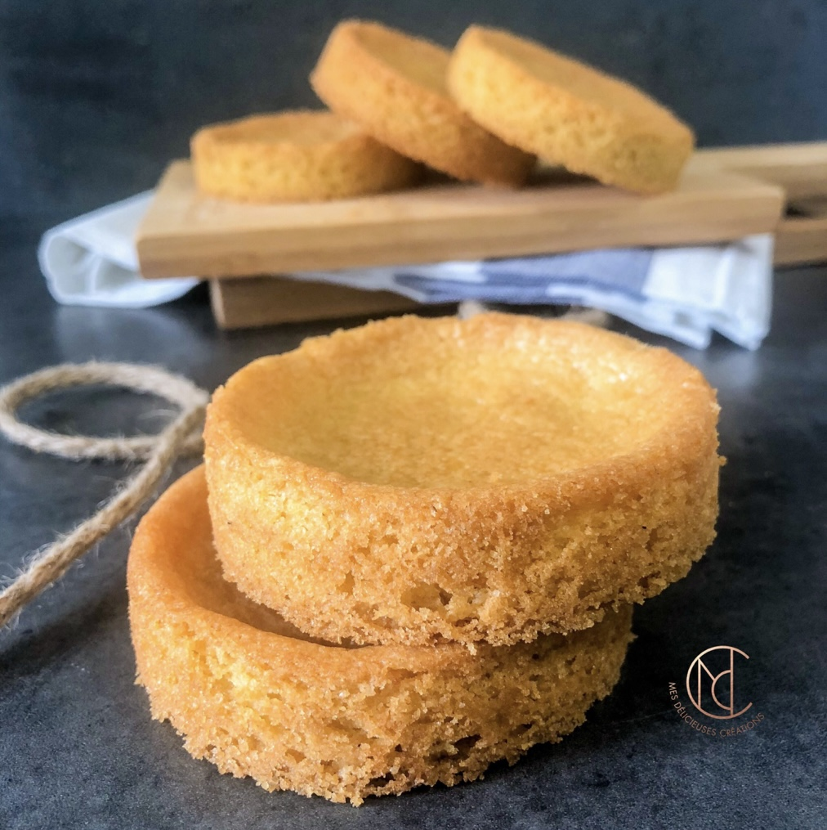
Palet breton
It’s a buttery cookie

Slide 7
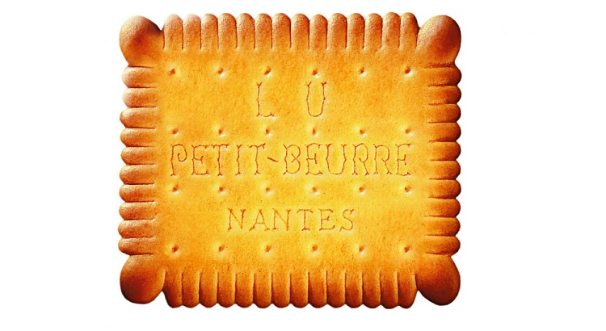
Petit beurre
It’s a well-known cookie made in Nantes

Slide 8
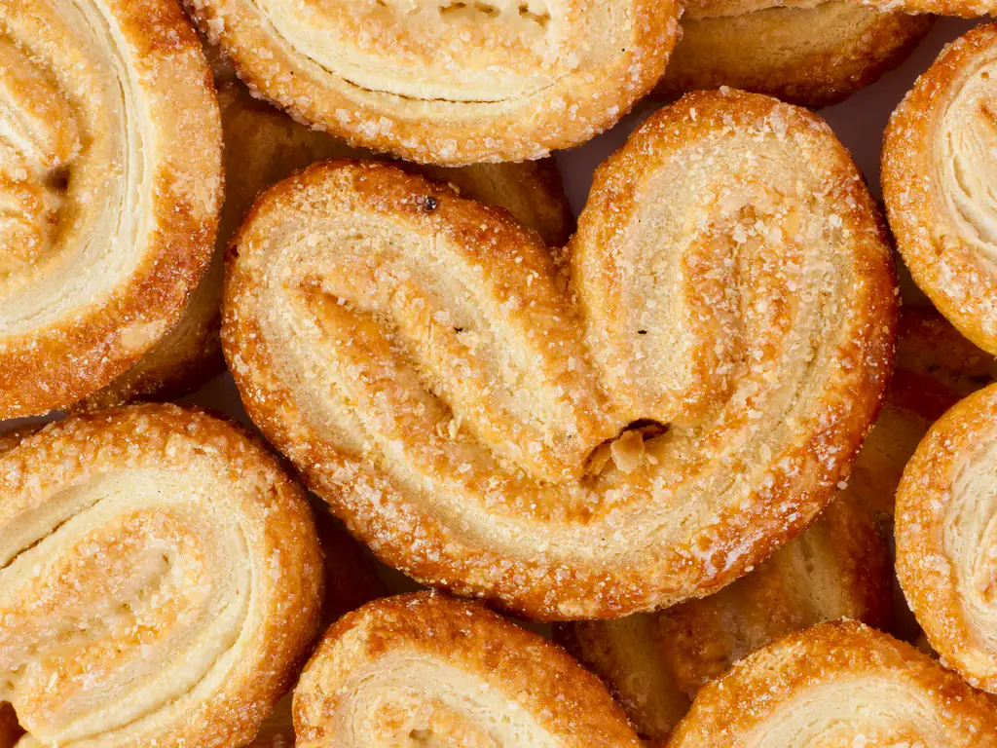
Palmier
It’s a heart-shaped puff
pastery cookie

Slide 9
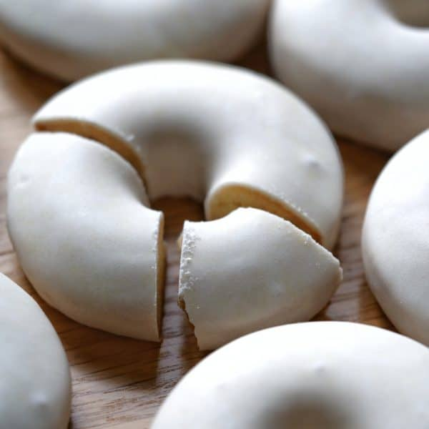
Rousquille catalane
It’s a donut-shaped cookie made of flour and covered with lemon-anise icing.

Slide 10
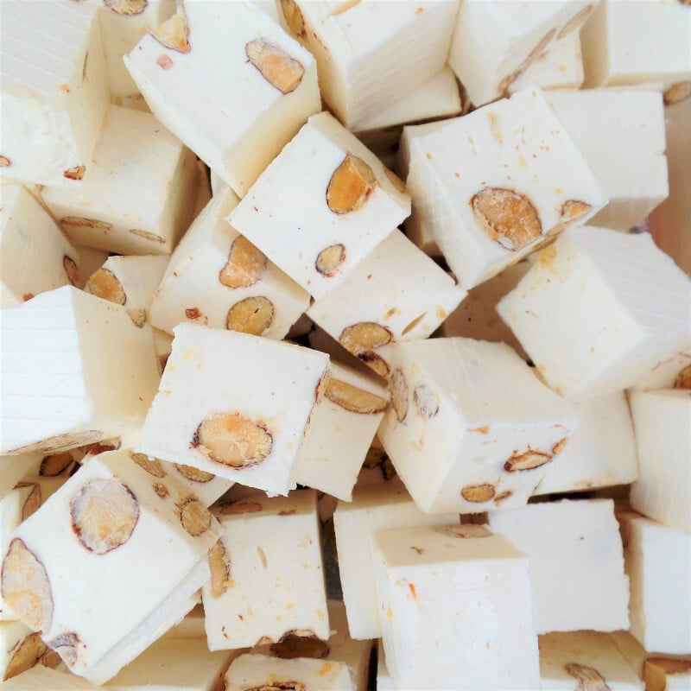
Nougat
It’s a Candy made of egg whites and almonds

Slide 11
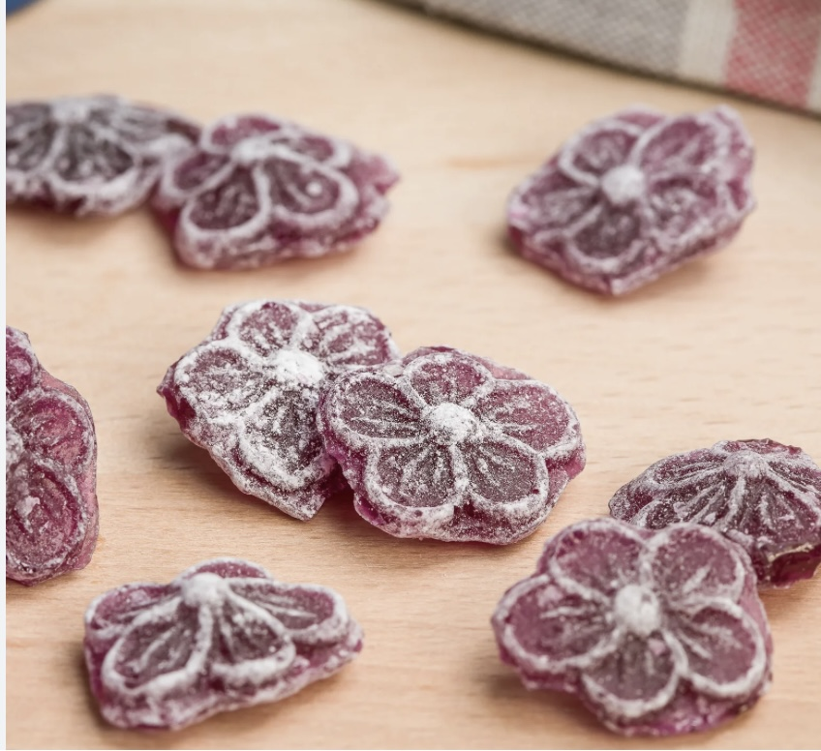
Les violettes de Toulouse
It’s a Candy made of violets

Slide 12
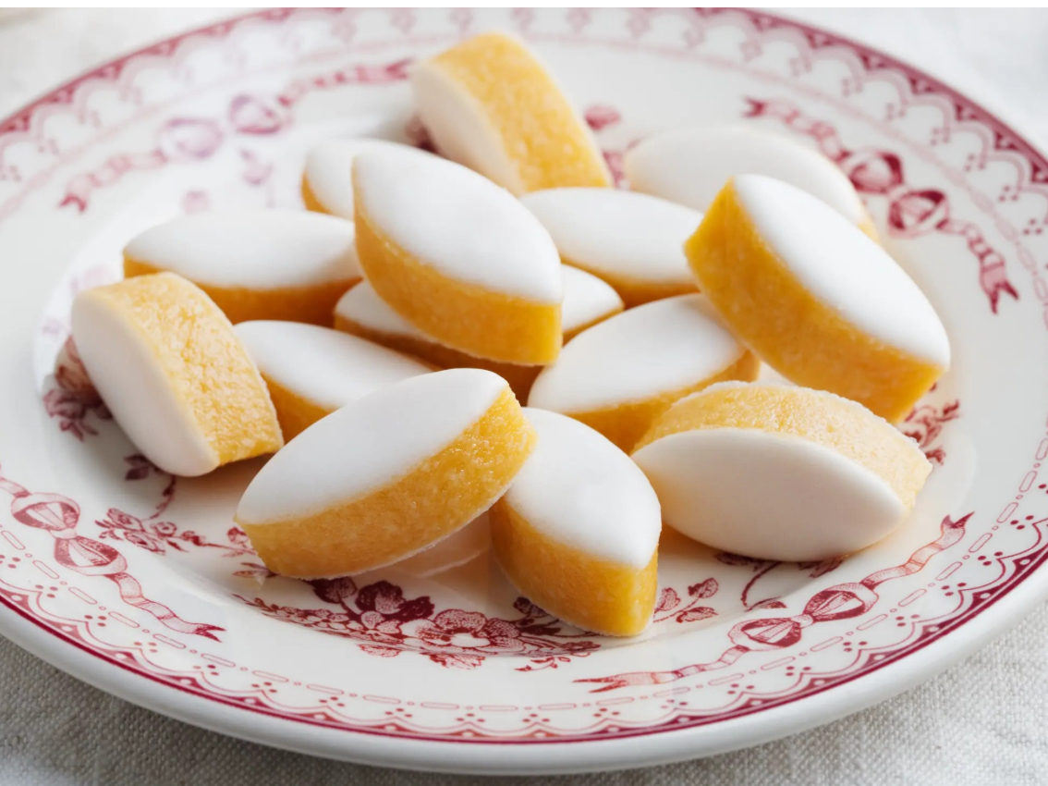
Les calisson d’aix en provence
It’s a Candy made of
Marzipan (almonds)

Slide 13
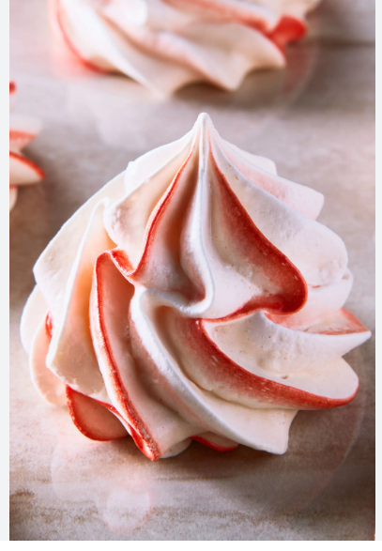
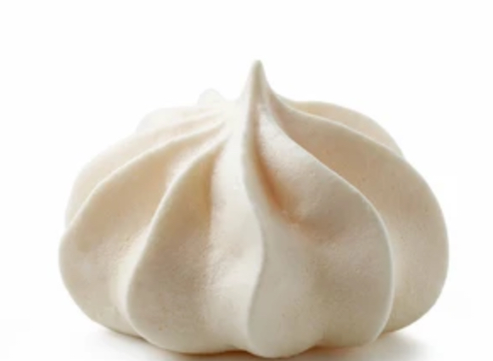
Meringue
Meringues are a French pastry made from whipped egg whites and sugar , then dried in the oven at a low temperature giving it a sweet taste and a light texture.
They are smooth and crispy on the outside but chewy on the inside.
It can also be used in other pastries such as pavlova and meringue cake

Slide 14
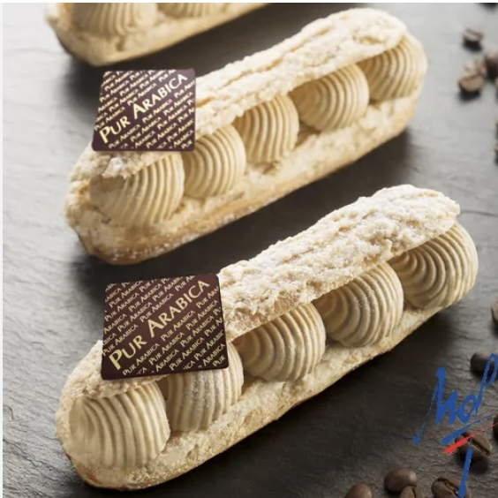
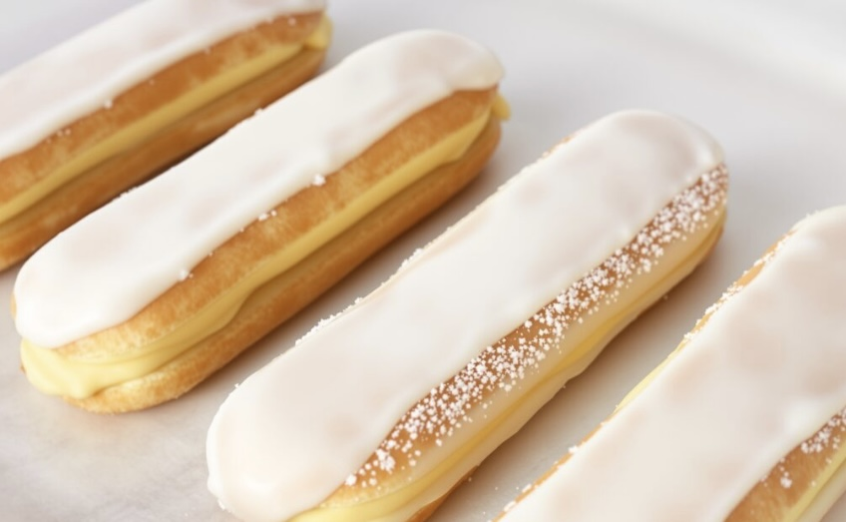
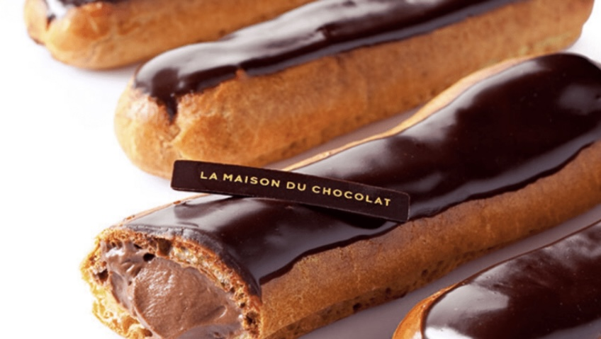
Éclairs
Éclairs are another type of pastry of French origin, made from *choux dough , a cream filling and topped with a flavored icing .
*Choux dough is made from butter, water ,flour and eggs
By Noëlly

